Slide 1
GameVault
An Online Videogame Store
Project by
Abid Hasan 1921700042
Shakib Taher Joy 2111845642

Slide 2
Whats the Website About?
“GameVault” is an online game store selling a variety of old and new games, consoles and accessories, built using HTML and CSS and the scripting language used is PHP. In this website the user would be able to log in or sign up and browse through games and consoles and digital tools related to video games such as HDMI cables and memory cards through the lists available.

Slide 3
There would be a list of 8 recommendations and a list of 10 latest released games as a jumping off point for the user. An option of ordering games from suppliers specifically for the admin is available.

Slide 4
Database Structure?
The database would be built by the entity relationship model using SQL. There would be 8 entities in total; There is a “User” who logs in signs up and IS A “Customer” or an “Admin”, the admin manages the “Product”, which IS A “Game”, “Console” or an “Accessory”. The customer orders a product and the “Order-receipt” is prepared if the order is finalized. The admin can buy products from a “Supplier” .
A user with any given email address and username can sign up only once, and 1 customer can buy 1 product at a time. The admin can buy many product from 1 supplier at a time.

Slide 5
What's the Layout?
While logging in the user would be giving their username and password, and while registering, the username, password and phone number.
Inside the website all users would be able to navigate a menu bar that has “Menu”, “Games”, “Consoles” , “Accessories”, “Log In” and “Sign Up”, but upon entering as an Admin another menu option called “inventory” would appear.
The admin has the special privileges of checking the list of orders, restocking games and browsing and deleting user accounts.

Slide 6
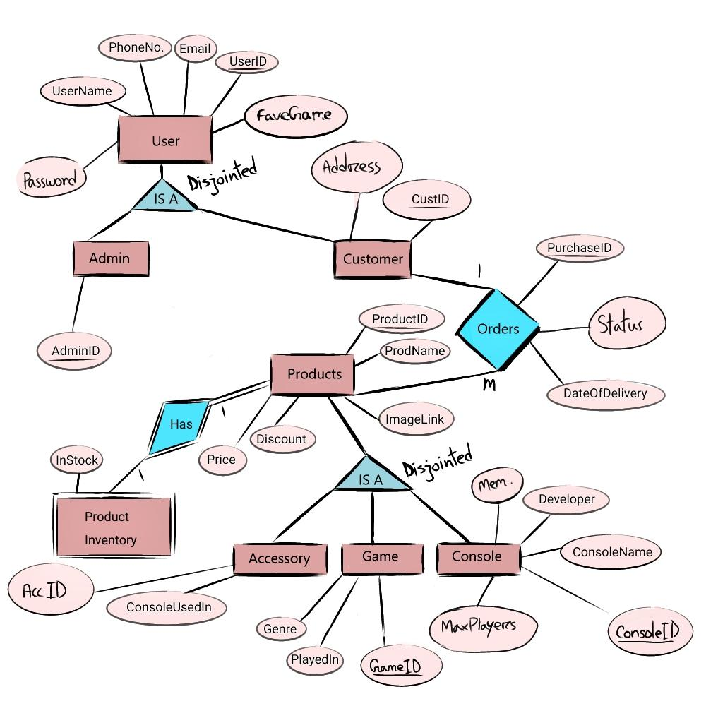
ER Diagram

Slide 7
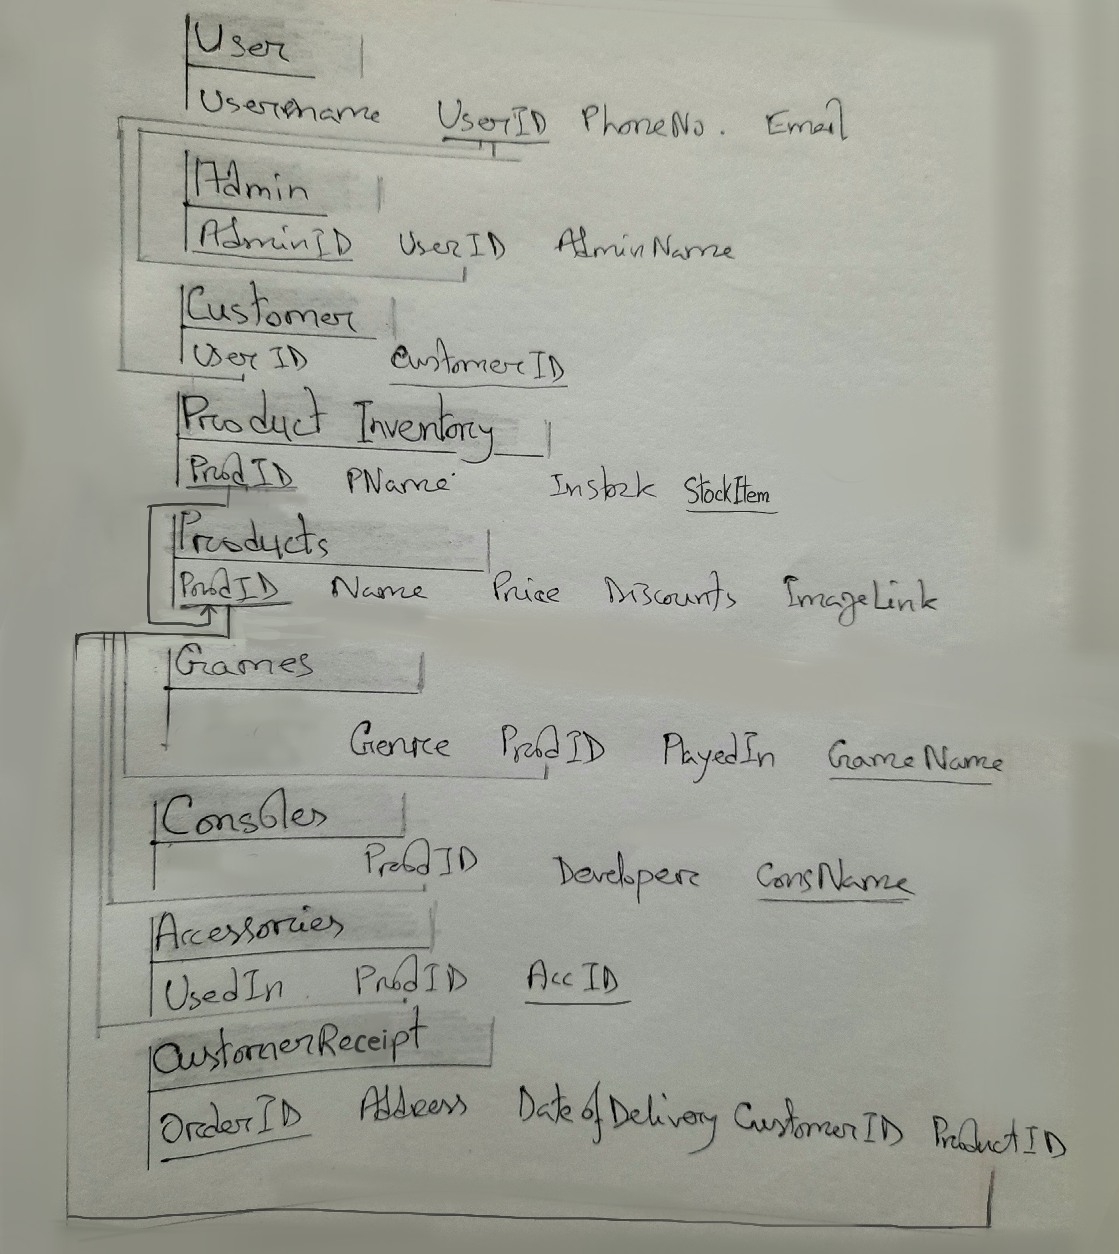
ER Relationship Model

Slide 8
2NF Normalized Tables
User
Username
UserID
PhoneNo.
Email
Password
Admin
AdminID
UserID
AdminName
Customer
UserID
CustomerID
Name
Phone no.
Address
ProductInventory
ProdID
Name
InStock

Slide 9
Products
ProdID
Name
Price
Discounts
ImageLink
Game
Product id
Game Name
Minimum memory size
Maximum no. of players
Accessory
Product id
Accessory name
details
Console
Product id
size
DriveType
OrderReceipt
OrderID
Address
DateOfDelivery
CustomerID
ProductID
OrderStatus

